Slide 1
Not Your Average Plummer
Developer : Sean Radatz
ITCS 1950
Project 3

Slide 2
Characters / Items
Antonio
The main character / plummer
Coins
Mushrooms
Super Star
All worth a variety of points
Spikes
Careful they will end the plummer’s adventure

Slide 3
Story/Premise
Play as a plummer in a strange world
Goal: Collect as many Coins, Mushrooms and Super Stars as possible to get the highest score
Kept simple for ease of play
Some items are much harder to get for those that want the highest score

Slide 4
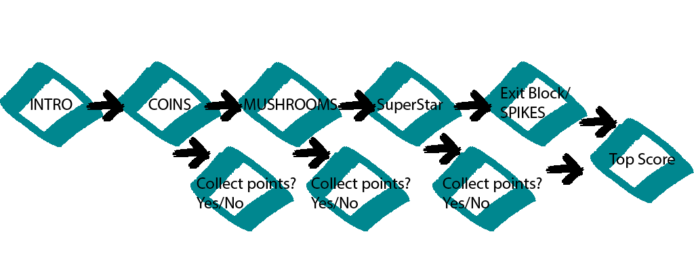
Game Map

Slide 5
What’s Unique about the game
Fast gameplay
Competitive
Replay value
Easily transferred to other platforms
Special Items that can be fun to collect
Hurtful items to watch out for

Slide 6
Why you should invest
Everyone want to be a plummer.
So we can all go get a beer after this presentation

